Slide 1


Slide 2
Parking ticket management system
By
Nasir khan 2212231
Baneen Fatima 2312230

Slide 3
ABOUT project
This project operates a parking system, facilitating ticket reservations for various vehicles, displaying totals, deleting records, and enabling vehicle searches. It also includes a password authentication feature for system access.

Slide 4
Pseudo code
Define constants:
- Messages and prompts
- Parking rates for vehicles
- Maximum parking capacity
Define variables:
- amount: Total amount earned
- count: Total vehicles parked
- bike, c, b: Counts for specific vehicle types
- pass1: Admin password
- ... (other variables used for messages, user input, etc.)

Slide 5
Pseudo code 2
Define procedures:
- passs: Validates the admin password
- motorbike: Processes parking for motorbikes
- caar: Processes parking for cars
- buss: Processes parking for buses
- recrd: Displays total records and earnings
- delt: Deletes all records
- search_vehicle: Searches and displays parked vehicle count by type
- newline: Prints a newline
Main procedure:

Slide 6
Pseudo code 3
Initialize data segment
Call passs to validate admin password
Loop while handling user input:
Display the menu options
Read user input and handle based on selection:
- Motorbike: Increment count, add to amount, update bike count
- Car: Increment count, add to amount, update car count
- Bus: Increment count, add to amount, update bus count
- Show total records: Display total vehicles, amounts, and counts by type

Slide 7
Pseudo code 4
- Delete records: Reset all counts and amounts to zero
- Search vehicle: Display counts for a specific vehicle type
- Exit: Terminate the program
Terminate the program

Slide 8
Snippets of code

Slide 9
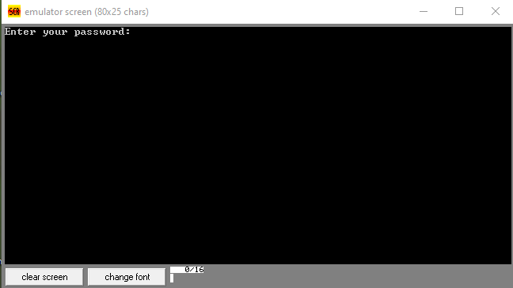
Out put 1

Slide 10
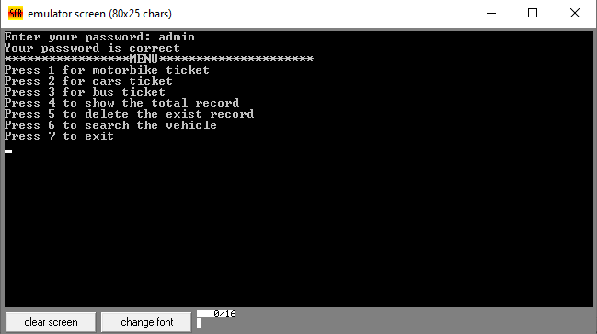
Ouput 2

Slide 11
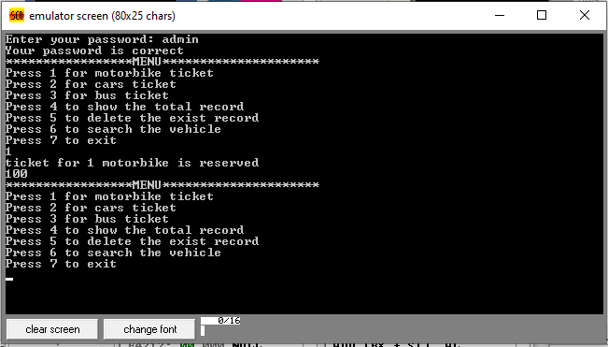
Out put 3

Slide 12
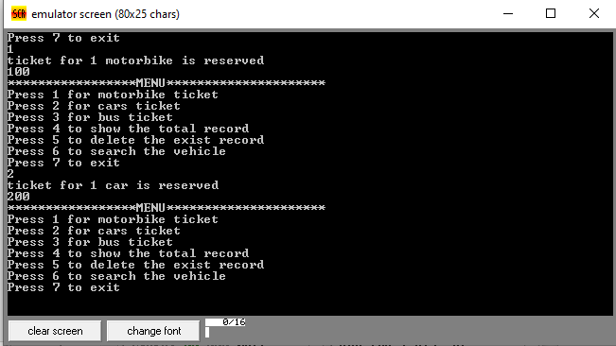
Ouput 4

Slide 13
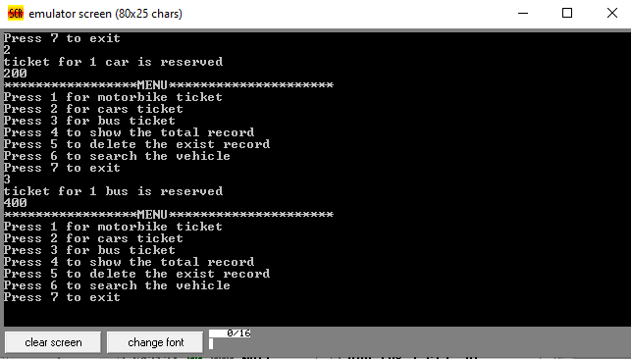
Out put 5

Slide 14
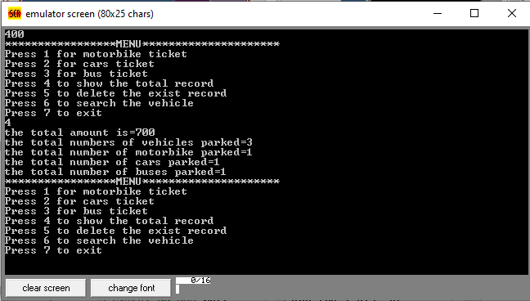
Ouput 6

Slide 15
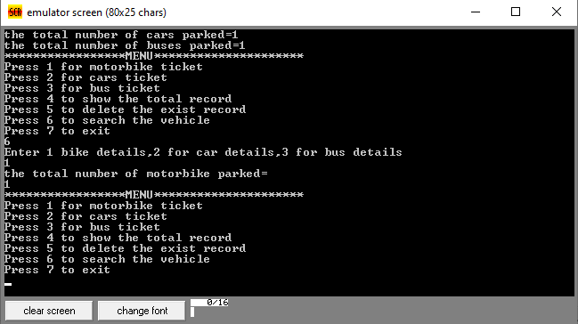
Out put 7

Slide 16
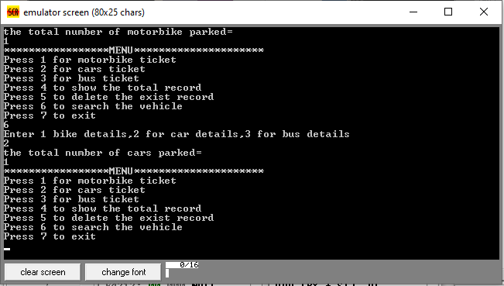
Ouput 8

Slide 17
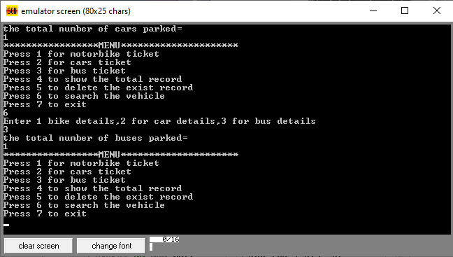
Out put 9

Slide 18
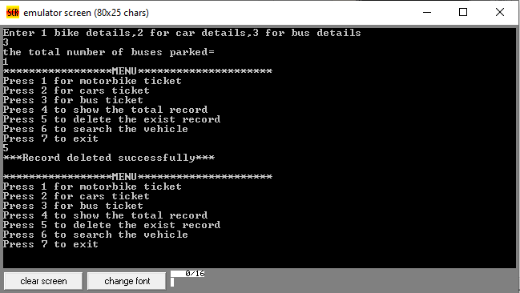
Ouput 10

Slide 19
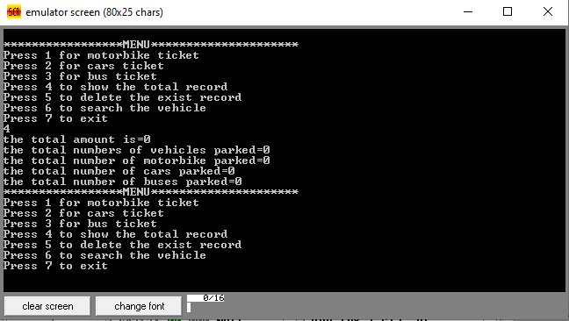
Out put 11

Slide 20
THANK YOU

Slide 21
Any question

